Slide 1
Operating Systems
Computer System Architecture, Operating System Structure
(Week 2)

Slide 2
Today
Computer System Architecture
Single v.s. Multiple Processor System
General v.s. Special Purpose System
System Structure
Different User Interface (UI).
System Calls in OS.
Services Provided by the OS.

Slide 3
Computer Architecture – OS - Relationship
Different computer systems, different requirements.
Understand the nature of the system.
Understand the requirements.

Slide 4
Computer-System Architecture
Most systems use a single general-purpose processor.
Multiple processors systems growing in use.
Computer Systems
Single Processor Systems
Multiple Processor Systems
Multiprocessor Systems
Clustered
Systems
Distributed
System

Slide 5
Multiprocessor Systems
A computer system having multiple processors sharing the same common memory.
Advantages:
Increased Throughput
Economy of Scale
Increased Reliability
Graceful Degradation
Fault Tolerance
Two types:
Asymmetric Multiprocessing
Symmetric Multiprocessing

Slide 6
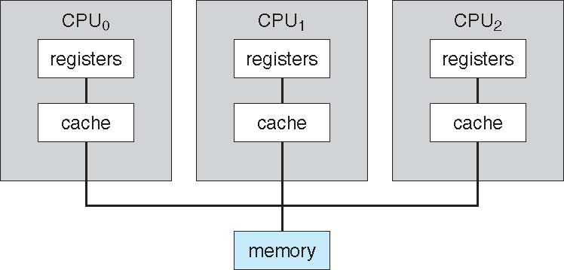
Symmetric Multiprocessing Architecture
Each processor can perform all tasks within the OS.
All serve as peers, no master-slave relationship.
Print
Write
Calculation
Graphic
Input

Slide 7
Asymmetric Multiprocessing Architecture
Each processor is assigned with a specific task.
A master processor controls the system.
The master schedules work for the slave processors.
Processor
A
Processor
B
Print
I/O
DVD
Write
Printer
Calculation
Graphic
Memory
Input

Slide 8
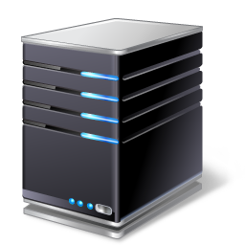
Clustered Systems
Another type multiprocessor system.
Multiple systems working together.
Sharing storage via a storage-area network (SAN).
Interconnect
Interconnect
Storage-Area
Network

Slide 9
Clustered Systems
To provide high-availability service that survives failures.
Two types:
Asymmetric Clustering:
One machine in hot-standby mode.
Symmetric Clustering
Multiple nodes running applications, monitoring each other.
To provide high-performance computing.
Applications must be written to use parallelization.
Divide a task into separate subtasks that run in parallel.

Slide 10
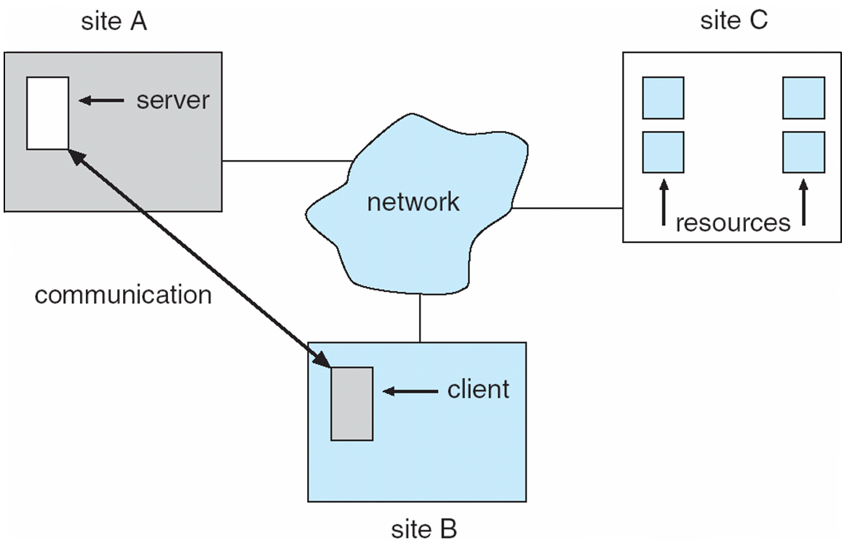
Distributed System
Collection of physically separated, heterogeneous (mixed) computer systems that are connected together.
Advantages:
Access to various resources.
Increases:
Computation Speed
Functionality
Data Availability
Reliability

Slide 11
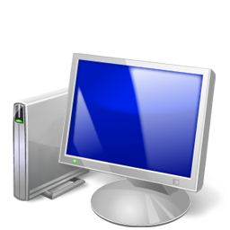
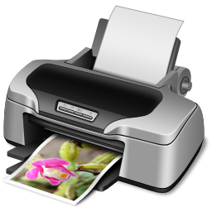
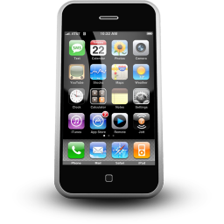
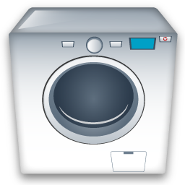
Computer-System Architecture
Computer system can be categorised into general purpose and special purpose systems as well.
Computer Systems
General Purpose Systems
Special Purpose Systems
Embedded
Systems
Handheld
Systems

Slide 12
Embedded System
Design to perform very specific tasks.
System they run on are usually primitive (limited features).
Have little or no user interface.
Spend most of the times on monitoring and managing.
Example:
Printer, Scanner, Robotic Arms
Requirement:
Processing to be done within the defined constraints.

Slide 13
Handheld System
Small size (limited resources).
Smaller amounts of memory.
Slower processors.
Example:
Cellphone, PDA.
OS:
iOS, Android, Windows, Symbian.
Requirements:
Efficient memory management.
Not to burden the processor.
Design of I/O interface.

Slide 14
System Structure
Different User Interface (UI).
System Calls in OS.
Services Provided by the OS.

Slide 15
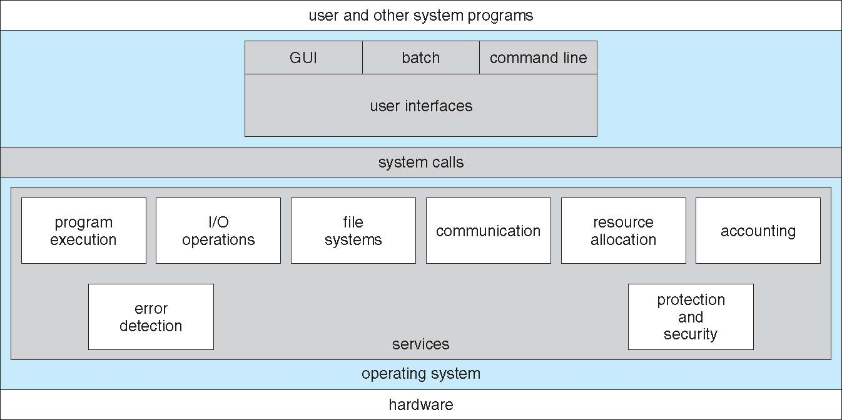
A View of Operating System Services

Slide 16
User Operating-System Interface
Two types:
Command-Line Interface (CLI)
Graphical User Interface (GUI)

Slide 17
User Operating-System Interface Command Interpreter
Primarily:
Command:
Built-In
Interpreter contains the code to execute the command.
System Programs
Locate the file associated with the command.
Load the file and execute the code inside.
Allow command to be added easily.
Fetch Command
Execute

Slide 18
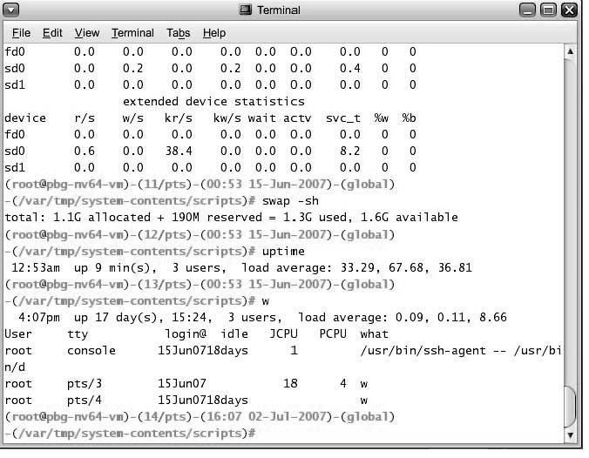
Bourne Shell Command Interpreter

Slide 19
User Operating-System Interface Graphical User Interface
User-Friendly (Desktop Metaphor Interface).
Mouse + Keyboard + Monitor
Icon:
Files / Programs
Actions
Etc…
Mouse clicks:
Provide information.
Execute function.
Etc…

Slide 20
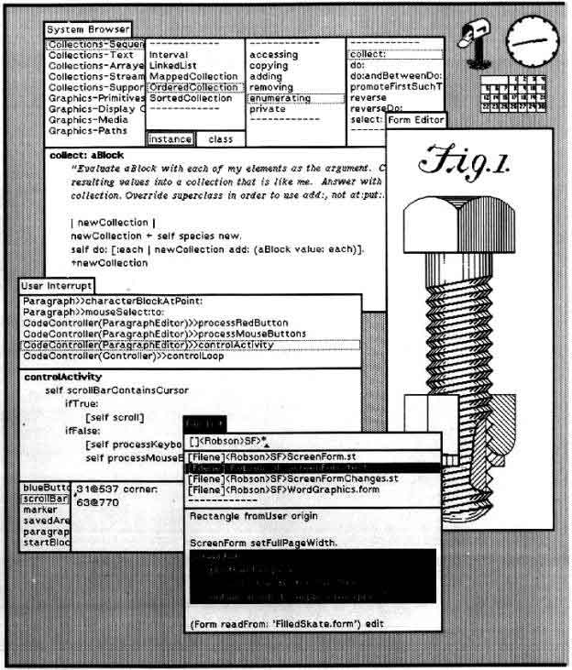
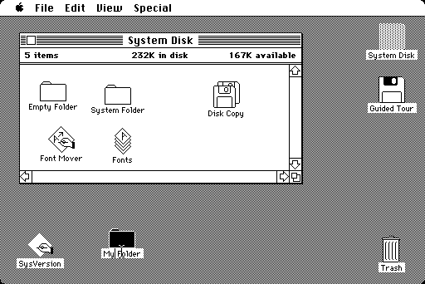
User Operating-System Interface Graphical User Interface
Apple Macintosh
Xerox Alto

Slide 21
User Operating-System Interface Graphical User Interface
Many systems now include both CLI and GUI.
Windows:
GUI with CLI “Command” Shell
Mac OS X:
“Aqua” GUI with UNIX Kernel + Shell
Solaris
CLI + Optional GUI (KDE, Java Desktop)

Slide 22
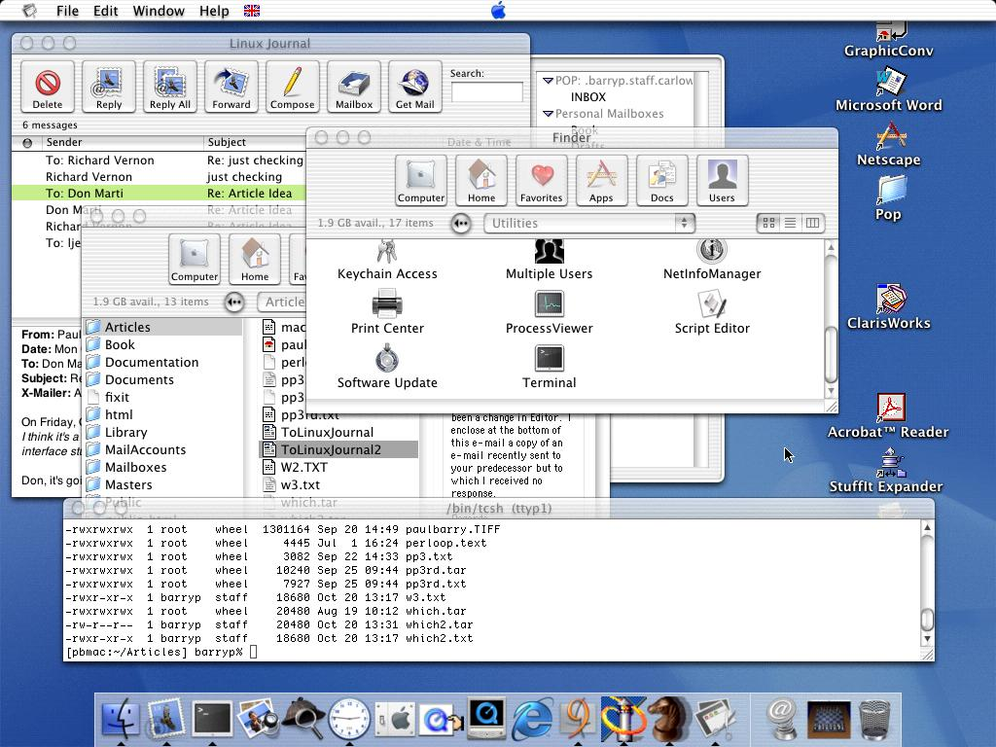
The Mac OS X GUI + Shell

Slide 23
Interaction – I/O and Operating System
Modern OSs are interrupt driven, not polling driven.
OS will sit quietly (idle), if:
There are no processes to execute.
No I/O devices to service.
No users to respond.
When something happen (events), an interrupt is generated.
OS will deal with the interrupt and determine the action that should be taken.

Slide 24
A View of Operating System Services

Slide 25
System Calls
For a user program to request the OS to perform tasks (privilege instructions) reserved for the OS.
The privilege instructions can be executed only by the OS.
OS will execute the privilege instructions and return the results.
This is to prevent the misuse of hardware.
To achieve this, modern processor has two modes of operation:
User Mode
Processor can only execute non-privilege instructions.
Kernel Mode (System Mode)
Processor can execute all instructions.

Slide 26
System Calls and Dual-Mode Operation
NO:
user mode
user mode
mode bit = 1
user process executing
kernel mode
kernel mode
mode bit = 0
YES:
user mode
user mode
mode bit = 1
user process executing
calls system call
returns from system call
kernel mode
mode bit = 0
mode bit = 1
kernel mode
mode bit = 0
execute system call

Slide 27
System Calls and Dual-Mode Operation
If user program does not require the OS to perform privilege instructions, then no system call should be performed.
Besides, processor also does not need to switch from one mode to another.

Slide 28
System Calls
Mostly accessed by programs via a high-level Application Program Interface (API) rather than dealing with system calls directly.
Three most common APIs:
Win32 API for Windows.
POSIX API for POSIX-based Systems.
Java API for the Java Virtual Machine (JVM)
Why use APIs rather than system calls?

Slide 29
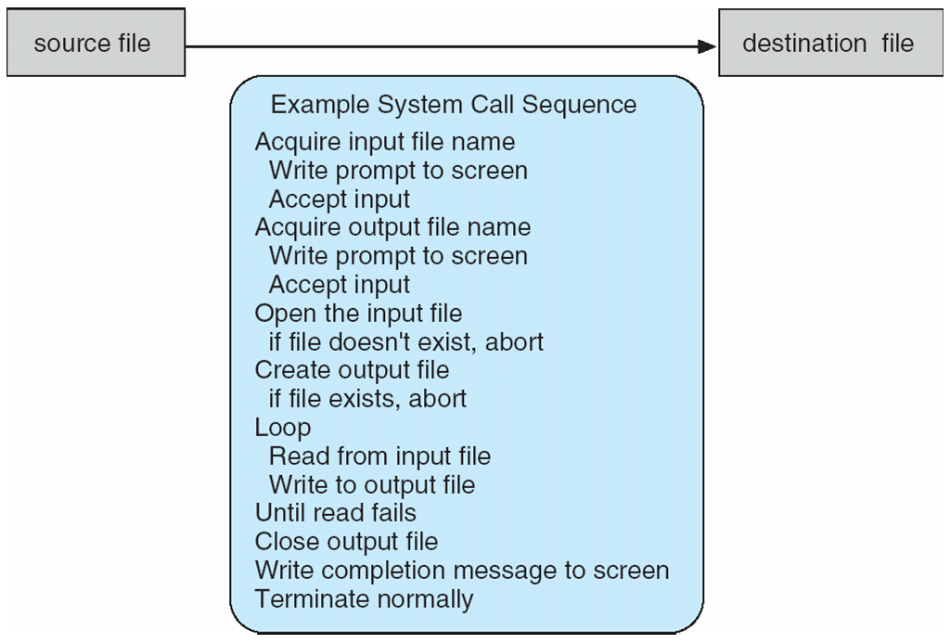
System Calls
Copy the contents of one file to another file.

Slide 30
System Call Implementation
Typically:
Each system call is associated with a number.
Caller
Initiate System Call
System Call Interface
Invoke System Call in OS Kernel
Return Status of System Call
Return Any Other Values

Slide 31
System Call Implementation
A program is not required to know how the system call is being implemented.
Just have to obey the API.
Understand what OS will do as a result call.
Details of OS interface hidden from programmer by API.
Managed by run-time support library.
Functions built into libraries included with compiler.

Slide 32
Types of System Calls
Process
Control
File Management
Communication
Type of System Calls
Device Management
Protection
Information Maintenance

Slide 33
Types of System Calls
Process Control
Allocate resources.
File Management
Create, Delete, Open, Close, Read, Write Files.
Device Management
Request for device before accessing.
Create / Terminate processes.
Get / Set process attributes.
Get / Set file attributes.
Release the device after job done.
Get / Set attributes.
Logically attach / detach devices..

Slide 34
Types of System Calls
Information Maintenance
Get / Set system data.
Communication
Create / Delete communication connection.
Protection
Provides mechanism for controlling access to resources.
Get / Set process, file, or device attributes.
Transfer status information.
Attach / Detach remote devices.
Send / Receive messages.

Slide 35
A View of Operating System Services

Slide 36
Operating System Services
Program Execution
User Interface
(UI)
Communication
Operating System Services
I/O Operations
File System Manipulation
Error Detection

Slide 37
Operating System Services
User Interface
(UI)
Almost all operating systems have a UI.
CLI, GUI, Batch…
Program Execution
Able to load a program into memory.
Run the program, and stop the program.
I/O Operations
Running program may requires for I/O.
I/O: File, I/O Devices (Printer, Scanner).

Slide 38
Operating System Services
Files Manipulation System
Manipulate files and directories.
Create, Delete, Set Permission…
Communication
Processes may exchange information.
Error Detection
Constantly aware of possible errors.
Via message passing / shared memory.
In CPU / Memory / I/O Devices / User Program.
Action to ensure correct and consistent computing.

Slide 39
System Programs
Application Programs
File Manipulation
Status Information
System Programs
Communication
File Modification
Program
Loading & Execution
Programming Language Support

Slide 40
System Programs
File Manipulation
Manipulate Files & Directories
Create, Delete, Copy, Rename, Print, etc…
Status Information
Format and print info to other output devices.
Registers for storing and retrieving information.
File Modification
Text editor to create and modify files.
Search contents, perform transformation of text.
Programming Language Support
Compilers, Assembles, Debuggers, and Interpreters.
*Not all OS provides all these kind of supports.

Slide 41
System Programs
Application Program
Help the user to solve common problems.
Program Loading
+
Execution
Absolute, Relocatable, Overlay Loaders, Linkage Editor
Debugging systems for higher level and machine language.
Communications
Provide mechanism for creating virtual connections.
Send messages to another’s screen, e-mail, etc…
Among processes, users, and computer systems.
Performing common operations.

